Slide 1

Website
Email
Twitter
Facebook
Medium
lium.io
lium_info@lium.io
https://twitter.com/Liumo cial
https://www.facebook.com/liumproject
https://medium.com/lium-project

Slide 2



Mission
GLOBRIDGE is composed of the word global and bridge, in connotation to providing resolutions to the presently prevailing issues of intermediaries as well as aiming to creating a platform to connect whomever, whenever and wherever without the limits of any restrictions.
GLOBRIDGE not only pursues job searches of those between individuals and companies, but also plans to endorse various intermediary services including trades of Real-Estate, Used cars, as well as E-commerce.
Moreover, GLOBRIDGE proposes a space which will incorporate all fields of B2B, C2C, C2B, as well as B2C, and with the utilization of a blockchain based penalty system, reward system and a matching system, GLOBRIDGE promises a reliable intermediary system for all our users.
GLOBRIDGE will become the forerunner of the global market with innovative and differentiated services.
Mission
GLOBRIDGE is composed of the word global and bridge, in connotation to providing resolutions to the presently prevailing issues of intermediaries as well as aiming to creating a platform to connect whomever, whenever and wherever without the limits of any restrictions.
GLOBRIDGE not only pursues job searches of those between individuals and companies, but also plans to endorse various intermediary services including trades of Real-Estate, Used cars, as well as E-commerce.
Moreover, GLOBRIDGE proposes a space which will incorporate all fields of B2B, C2C, C2B, as well as B2C, and with the utilization of blockchain based penalty system, reward system and a matching system, GLOBRIDGE promises a reliable intermediary system for all our users.
GLOBRIDGE will become the forerunner of the global market with innovative and differentiated services.
Vision
Containing
All Transactions of
the World
Liberation from
Intermediaries
Global Service
Become the
Top Leading Company
1
2
3
4
01
02

Slide 3

Market
Insight
6
Real Estate
Agency Trade Deal
Trillion Won
Opportunity
Problems
The online market has developed laterally with the advancement
of Internet technology as well as online transactions. Conversely,
the foremost problem of monopolization and the enlargement of
brokerage platforms in the online market remain unresolved. Thus,
GLOBRIDGE will be the solution to these complications through its
innovative services by continuously corresponding to its supply
and demand.
Markets where buyers and sellers transact through the platform
are referred to as two-sided markets. Often in two-sided markets,
intermediaries are found who often utilize promotions or service
polices as their early marketing strategies. Nonetheless, once the
platform has matured, many cases are found where intermediaries
by stand to false information or high commission fees within the
platform.
111
Total Size of
E-Commerce
Trillion Won
Two- Sided Market
Major
Minor
Major
Sellers
Intermediaries
Consumers
5
After Obtaining a Monopoly Status
Employment
Market
Trillion Won
110
Used Car Sales
Billion Won
Major
Minor
Major
Sellers
Intermediaries
Sellers
03
04

Slide 4

Solutions
Of
GLOBRIDGE
Reward System
The current existing reward system is primarily focused on closed and impractical advertisement policies.
This causes a lack of motivation for the users to provide the service with enhanced quality information, initiating no subsidy for the service providers.
The GLOBRIDGE platform however, compensates rewards for its users for all activities that they provide. Thus, this allows for an environment where users are encouraged to continuously provide the platform with their information due to the high motivator of rewards.
Athough posts within the platforms are not automatically altered, if one believes that there is a post with misleading information all is free to report the post. If the reported posts are found to be misleading information, GLOBRIDGE is given the rights to intervene. The reporter is given rewards for the right doing and penalty is given to the prohibited for their wrong.
Penalty
System
If one receives two yellow cards, they will be removed from the platform and the information will be saved through GLOBRIDGE’s blockchain technology. This system was built on the intention so that all users will provide only with correct information.
Peer
Review
The GLOBRIDGE platform comprises of an evaluation system where users are to assess one another after each match has been completed. The given period for each evaluation is one week, and the faster the assessment has been completed, users are to be compensated with higher rewards.
The system also comprises of a reporting function in which one can apply others for punishment if they feel they have received too little of scores or reports. The rules for this system are equivalent to that of the penalty system. Additionality, if one who has been reported feels that the report has been unreasonably intended, they may speak up their opinions within 7 days though a 1:1 chatting system provided by GLOBRIDGE.
GLOBRIDGE is a platform that will modify the traditional ways of intermediary services. Thus, it will focus to put an emphasis on giving power to both the service providers and users that used to devise less authority.
Therefore, whomever repeatedly posts false information on the platform will be reported, and those who report valid and correct information will be compensated raising credibility and service with low commission fee through GLOBRIDGE’s guaranteed escrow services. In this form, users and providers within the service will be benefitted mutually.
Strict Standard,
Liberalized Matching
05
.
06

Slide 5

GLOBRIDGE Token
3% Advisor, Community
2% Legal
Token Allocation
Total Issued Amount
4.95 Billion (4,950,000,000)
Economy
15%
Operation
GB Cash / a = PICK
a = Daily Crypto Currency Rate
GB Cash is used in the same sense as mileages or as point systems within the service. This is to explain the nature of trading and exchanging within cryptocurrencies which results in delays and commission fees. Thus, the direct use of PICK will not be utilized for these very reasons. Therefore, PICK will only be used in the service for the use of purchasing GB Cash and for when given out to the users.
35%
Angel Investors,
Token Sales
20%
Business Operation
R&D
25%
Corporation
PICK
Exchange
Once purchasing PICK from the exchange, it must be converted through the GB Wallet to the right amount of GB Cash. However, rewards for some specific activities of the users will be paid in PICKs. This is because GB Cash cannot be cashed.
GB Cash
Cash
Token
Purchase
5% Legal
Points Exchange
Fund
Distribution
User
GB Wallet
25%
Development
Service
15%
Reserve
Utilization
Reward
GLOBRIDGE
Service
Yellow Card
Provision of False
Information
15%
Marketing
20%
Operation
20%
R&D
Reward System
07
08

Slide 6


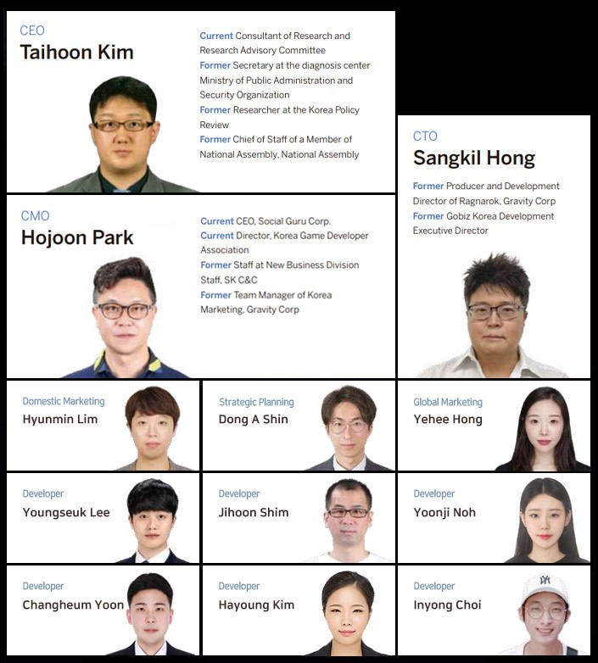
Roadmap
2018
4Q
- Concept of GLOBRIDGE
- Market Research
2019
1Q
- Team Composition Finalized
- White paper V.1.0
- GLOBRIDGE E-Wallet Development Plan
2Q
- Completion of the GLOBRIDGE Homepage
- Whitepaper V.1.1
- Initial Development of the GLOBRIDGE E-Wallet
3Q
- Establishment of GLOBRIDGE Corporation
- Issuing of Tokens / Whitepaper V 1.2
- GLOBRIDGE E-Wallet Development Completed
- Planning of GLOBRIDGE Platform Server
Team
YeonJung Yeo
2020
3Q
- 1st dApp Service(JOBus)
-Marketing through both On and Off-line
4Q
-Planning of 2nd dApp Service
-Planning of GLOBRIDGE Service Portal
4Q
Planning and Development of the 1st dApp
Service
GLOBRIDGE Portal Architecture Planning
Exchange Listing (BW)
2021
1Q
-Lauch of 2nd dApp Service
-Improvement of 1st dApp Service
2Q
-Planning of 3rd dApp Service
Improvement of 2nd dApp Service
09

